Slide 1
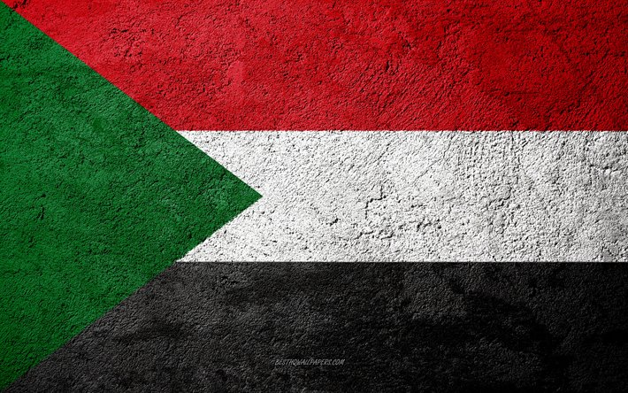
Sudan & Culture
Made by Muhammad Arsalan Afzal Grade 11-O

Slide 2
BRIEF
Sudan, officially the Republic of the Sudan, is a country in Northeast Africa. It borders the countries of Central African Republic, Chad, Egypt, Eritrea, Ethiopia, Libya, South Sudan, and the Red Sea. It has a population of 44.91 million people as of 2021 and occupies 1,886,068 square kilometers (728,215 square miles), making it Africa's third-largest country by area, and the third-largest by area in the Arab League. It was the largest country by area in Africa and the Arab League until the secession of South Sudan in 2011, since which both titles have been held by Algeria. Its capital is Khartoum and its most populated city is Omdurman (part of metro Khartoum).

Slide 3
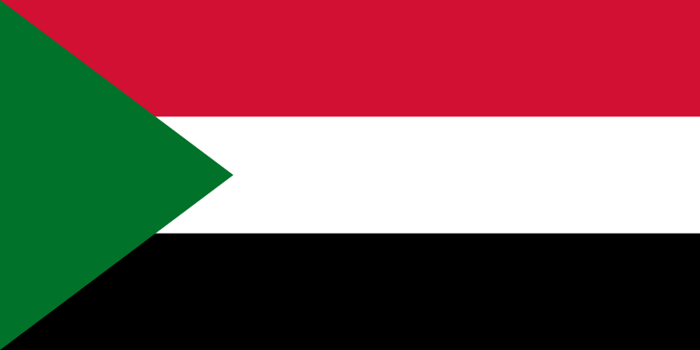
FLAG
The current flag of Sudan was adopted on 20 May 1970.

Slide 4
FLAG
The current flag of Sudan was adopted on 20 May 1970 and consists of a horizontal red-white-black tricolor with a green triangle at the hoist. The flag is based on the Arab Liberation Flag of the Egyptian Revolution of 1952, as are the flags of Egypt, Iraq, Syria, Yemen, and Palestine and formerly of the United Arab Republic, North Yemen, South Yemen, and the Libyan Arab Republic.
Whereas there is no fixed order for the Pan-Arab Colors of black, white, red, and green, flags using the Arab Liberation Colors (a subset of the Pan-Arab Colors) maintain a horizontal triband of equal stripes of red, white, and black, with green being used to distinguish the different flags from each other by way of green stars, Arabic script, or, in the case of Sudan, the green triangle along the hoist. In the original Arab Liberation Flag, green was used in the form of the flag of the Kingdom of Egypt and Sudan emblazoned on the breast of the Eagle of Saladin in the middle stripe. For 13 years from Sudan's independence in 1956 to the 1969 military coup of Gaafar Nimeiry, Sudan used a tricolor flag of blue-yellow-green.

Slide 5
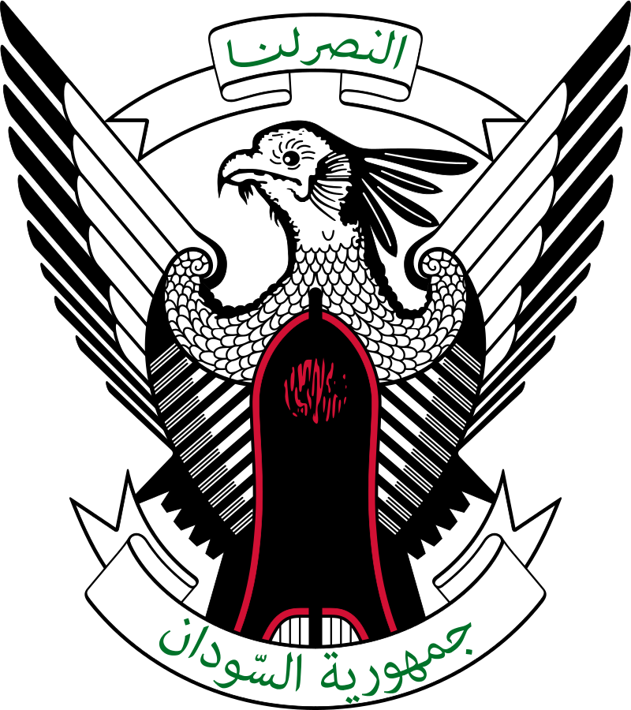
EMBLEM
The emblem shows a secretary bird bearing a shield from the time of Muhammad Ahmad, the self-proclaimed Mahdi who briefly ruled Sudan in the 19th century.

Slide 6
EMBLEM
The emblem shows a secretary bird bearing a shield from the time of Muhammad Ahmad, the self-proclaimed Mahdi who briefly ruled Sudan in the 19th century.
Two scrolls are placed on the arms; the upper one displays the national motto, “Victory is ours", and the lower one displays the title of the state, ("Republic of the Sudan").
The coat of arms is also the Presidential seal and is found in gold on the flag of the President of Sudan and on the vehicles carrying the President and at his residence.
The secretary bird was chosen as a distinctively Sudanese and indigenous variant of the "Eagle of Saladin" and "Hawk of Quraish" seen in the emblems of some Arab states, and associated with Arab nationalism (see Coat of arms of Egypt, etc.).

Slide 7
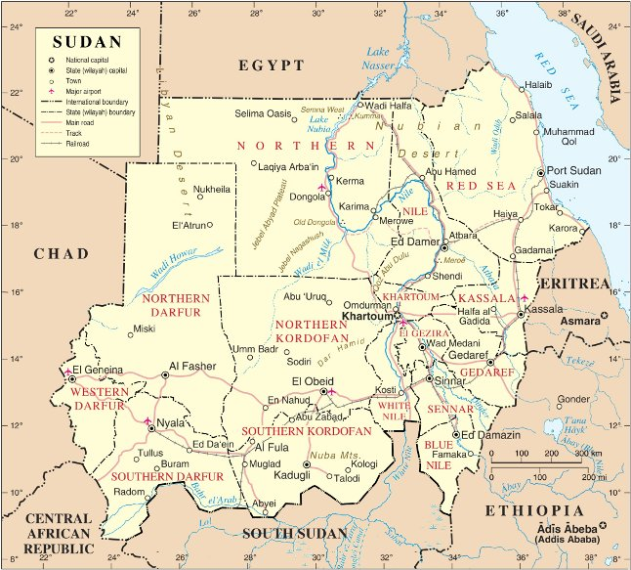
MAP
Sudan is situated in northern Africa, with an 853 km (530 mi) coastline bordering the Red Sea.

Slide 8
MAP
Sudan is situated in northern Africa, with an 853 km (530 mi) coastline bordering the Red Sea. It has land borders with Egypt, Eritrea, Ethiopia, South Sudan, the Central African Republic, Chad, and Libya. With an area of 1,886,068 km2 (728,215 sq mi), it is the third-largest country on the continent (after Algeria and Democratic Republic of the Congo) and the fifteenth-largest in the world.
Sudan lies between latitudes 8° and 23°N. The terrain is generally flat plains, broken by several mountain ranges. In the west, the Deriba Caldera (3,042 m or 9,980 ft), located in the Marrah Mountains, is the highest point in Sudan. In the east are the Red Sea Hills.
Rich mineral resources are available in Sudan including asbestos, chromite, cobalt, copper, gold, granite, gypsum, iron, kaolin, lead, manganese, mica, natural gas, nickel, petroleum, silver, tin, uranium and zinc.

Slide 9
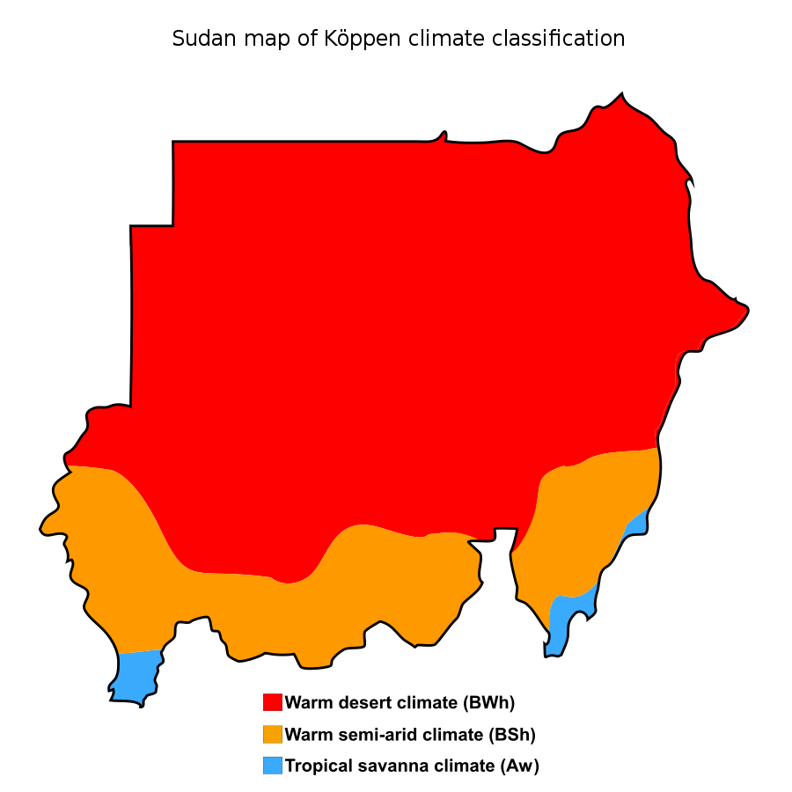
CLIMATE
Sudan is situated in northern Africa, with an 853 km (530 mi) coastline bordering the Red Sea.

Slide 10
CLIMATE
Although Sudan lies within the tropics, the climate ranges from hyper-arid in the north to tropical wet-and-dry in the far southwest. Temperatures do not vary greatly with the season at any location; the most significant climatic variables are rainfall and the length of the wet and dry seasons. Variations in the length of the wet and dry seasons depend on which of two air flows predominates: dry northern winds from the Sahara and the Arabian Peninsula or moist southwesterly winds from the Congo River basin and southeasterly winds from the Indian Ocean.
From January to March, the country is under the influence of dry northeasterlies. There is minimal rainfall countrywide except for a small area in northwestern Sudan where the winds have passed over the Mediterranean bringing occasional light rains. By early April, the moist southwesterlies have reached southern Sudan, bringing heavy rains and thunderstorms. By July, the moist air has reached Khartoum, and in August it extends to its usual northern limits around Abu Hamad, although in some years the humid air may even reach the Egyptian border. The flow becomes weaker as it spreads north. In September the dry northeasterlies begin to strengthen and to push south and by the end of December they cover the entire country. Khartoum has a three-month rainy season (July–September) with an annual average rainfall of 161 millimeters (6.3 in); Atbarah receives showers in August that produce an annual average of only 74 millimeters (2.9 in) millimeters.

Slide 11
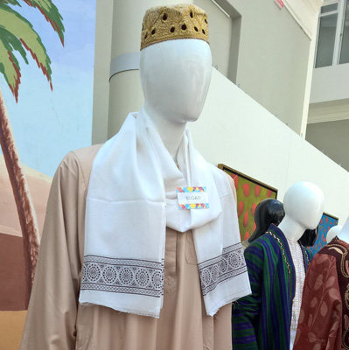
CLOTHES
National dress of Sudan. Men prefer loose-fitting robes and women use wrap-around cloths.

Slide 12
CLOTHES
Men's traditional attire. It consists of a long, loose-fitting white or pastel-colored robe (called "jalabiya"), a headdress (a skullcap or a turban), and shoes. Jalabiya is ankle-length collarless robe with long sleeves. Mostly it is light-colored, but sometimes it can be brown as well. Light colors help to reduce heat from the sun; long sleeves and hem protect skin from sun and sand; loose-fitting design helps skin to breath and reduces sweating.
Women's traditional attire. The national costume of Sudanese women is called "toob" ("thobe", "thawb", "toub" etc.). It is a long wrap-around cloth worn on top of a shirt and skirt/trousers. It covers the body entirely. It can be made from cotton, satin, polyester, jersey, denim and other fabrics. A thawb can be of any color, can have various patterns on fabric. A thawb can be very colorful and beautiful. Though, elder women prefer white thawbs, and youth mostly wears multicolor toobs, often with accessories. Expensive thawbs often are embellished with embroidery, stitch-work, rhinestones and other decorative elements.

Slide 13
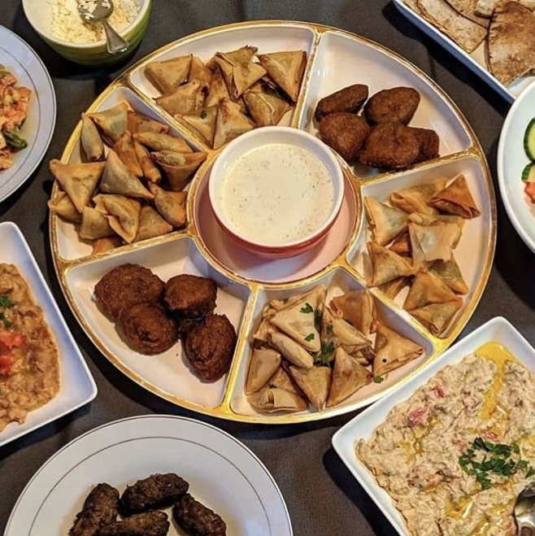
CUISINE
Sudanese cuisine consists of a generous share of stews and gravies—often eaten by hand—fresh and cooked salads, dips, lime, peanut, rice dishes, sweet and savory pastries, unique breads, and decadent desserts. In line with other Muslim-majority countries, lamb and chicken are the preferred meats.

Slide 14
CUISINE
Sundanese cuisine is the cuisine of the Sundanese people of West Java, and Banten, Indonesia. It is one of the most popular foods in Indonesia. Sundanese food is characterized by its freshness; the famous lalab eaten with sambal and also karedok demonstrate the Sundanese fondness for fresh raw vegetables. Unlike the rich and spicy taste, infused with coconut milk and curry of Minangkabau cuisine, the Sundanese cuisine displays the simple and clear taste; ranged from savory salty, fresh sourness, mild sweetness, to hot and spicy.
Sambal terasi is the most important and the most common condiment in Sundanese cuisine, and eaten together with lalab or fried tofu and tempeh. Sayur Asem vegetable tamarind soup is probably the most popular vegetable soup dish in Sundanese cuisine. Another popular soup is Soto Bandung, a soup of beef and daikon radish, and mie kocok noodle soup with beef meat and kikil.

Slide 15
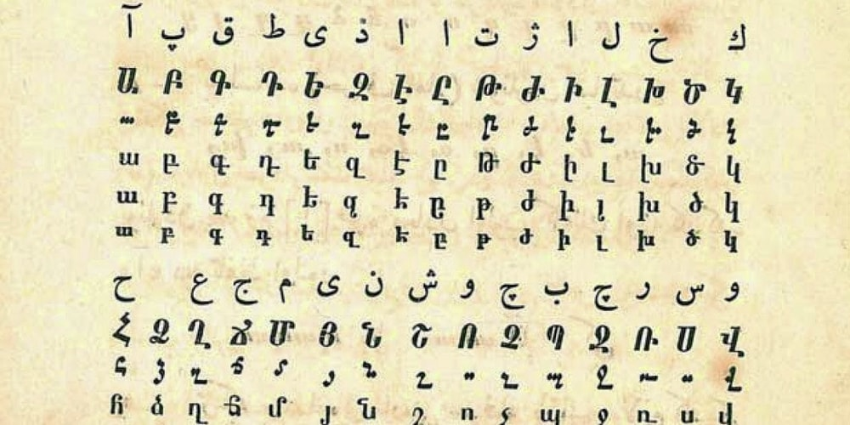
LANGUAGE
Sudan is a multilingual country dominated by Sudanese Arabic. In the 2005 constitution of the Republic of Sudan, the official languages of Sudan are Literary Arabic and English.

Slide 16
LANGUAGE
Sudan is a multilingual country dominated by Sudanese Arabic. In the 2005 constitution of the Republic of Sudan, the official languages of Sudan are Literary Arabic and English.
Most languages spoken in Africa fall into four language families. Three of them—Afro-Asiatic, Niger-Kordofanian, and Nilo-Saharan—are represented in Sudan. Each is divided into groups that are in turn subdivided into sets of closely related languages. Two or more major groups of each of the three families are present in Sudan, historically both a north–south and an east–west migration crossroads.

Slide 17
Thank You!
Make sure to take a trip to Sudan! And to https://jis-grade11.web.app/

